Slide 1
Unit 1: Introduction to programming
PROG0101 Fundamentals of Programming
1

Slide 2
Algorithm
PROG0101 Fundamentals of Programming
A sequence of instructions.
A procedure or formula for solving a problem.
Often used for calculation, data processing and programming.
Algorithms can be expressed in any language.
2

Slide 3
Examples Of Algorithms In Programming
Algorithm to add two numbers entered by the user
Step 1: Start
Step 2: Declare variables num1, num2 and sum.
Step 3: Read values num1 and num2.
Step 4: Add num1 and num2 and assign the result to sum. sum←num1+num2
Step 5: Display sum
Step 6: Stop

Slide 4
Pseudocode
PROG0101 Fundamentals of Programming
Pseudo code (which means fake code, because its not really programming code) specifies the steps required to accomplish the task.
Pseudocode is a type of structured English that is used to specify an algorithm.
Pseudocode cannot be compiled nor executed, and there are no real formatting or syntax rules.
4

Slide 5
Programming
Programming is the process of taking an algorithm and encoding it into a notation, a programming language, so that it can be executed by a computer.
Programming is often the way that we create a representation for our solutions.
Algorithms describe the solution to a problem in terms of the data needed to represent the problem instance and the set of steps necessary to produce the intended result.
Programming languages must provide a notational way to represent both the process and the data.

Slide 6
Difference between Algorithm, Pseudocode and Program
Algorithm : Systematic logical approach which is a well-defined, step-by-step procedure that allows a computer to solve a problem.
Pseudocode : It is a simpler version of a programming code in plain English which uses short phrases to write code for a program before it is implemented in a specific programming language.
Program : It is exact code written for problem following all the rules of the programming language.

Slide 7
Source Code
Source code is the language or string of words, numbers, letters and symbols that a computer programmer uses.
In computing, source code is any collection of code, with or without comments, written using a human-readable programming language, usually as plain text.
The source code of a program is specially designed to facilitate the work of computer programmers, who specify the actions to be performed by a computer mostly by writing source code.
The source code is often transformed by an assembler or compiler into binary machine code that can be executed by the computer.

Slide 8
Example of C Language Source Code
#include <stdio.h>
int main() {
// printf() displays the string inside quotation
printf("Hello, World!");
return 0;
}

Slide 9
The first line of the program #include <stdio.h> is a preprocessor command, which tells a C compiler to include stdio.h file before going to actual compilation.
The next line int main() is the main function where the program execution begins.
The next line (/*…*/ or //) will be ignored by the compiler and it has been put to add additional comments in the program. So such lines are called comments in the program.
The next line printf(…) is another function available in C which causes the message “Hello, World!” to be displayed on the screen.
The next line return 0; terminates the main() function and returns the value 0.

Slide 10
Standard I/O in C Language
When we say Input, it means to feed some data into a program. An input can be given in the form of a file or from the command line. C programming provides a set of built-in functions to read the given input and feed it to the program as per requirement.
When we say Output, it means to display some data on screen, printer, or in any file. C programming provides a set of built-in functions to output the data on the computer screen as well as to save it in text or binary files.

Slide 11
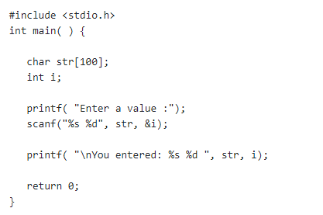
The scanf() and printf() Functions
The scanf() function reads the input from the standard input stream stdin and scans that input according to the format provided.
The printf() function writes the output to the standard output stream stdout and produces the output according to the format provided.
The format can be a simple constant string, but you can specify %s, %d, %c, %f, etc., to print or read strings, integer, character or float respectively.

Slide 12
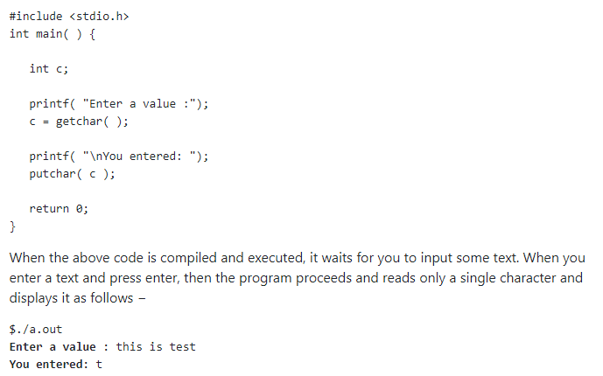
The getchar() and putchar() Functions
The int getchar(void) function reads the next available character from the screen and returns it as an integer. This function reads only single character at a time.
The int putchar(int c) function puts the passed character on the screen and returns the same character. This function puts only single character at a time.

Slide 13
Variables
A variable is a name of the memory location.
It is used to store data. Its value can be changed, and it can be reused many times.
It is a way to represent memory location through symbol so that it can be easily identified.
Syntax to declare a variable:
type variable_list;
Example: This is an example of programming expression.
z = x + y
x, y and z are variables.
Variables can represent numeric values, characters, character strings, or memory addresses.

Slide 14
Rules for defining variables
A variable can have alphabets, digits, and underscore.
A variable name can start with the alphabet, and underscore only. It can't start with a digit.
No whitespace is allowed within the variable name.
A variable name must not be any reserved word or keyword, e.g. int, float, etc.
Valid variable names:
int a;
int _ab;
int a30;
Invalid variable names:
int 2;
int a b;
int long;

Slide 15
Types of Variable
There are two types of variables:
1. Local variable
2. Global variable
Local variables are those that are in scope within a specific part of the program (function, procedure, method, or subroutine, depending on the programming language employed).
Global variables are those that are in scope for the duration of the programs execution. They can be accessed by any part of the program, and are readwrite for all statements that access them.

Slide 16
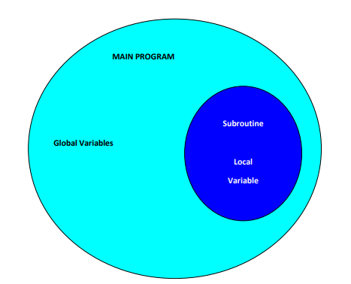
Types of Variable

Slide 17
Constants
Data items are sometimes required to keep their values throughout the program, hence the term constant.
A constant is a value that never changes.
A constant can be : –
a number, like 25 or 3.6
a character, like a or $
a character string, like "this is a string“
Example:
– Calculate area of circle
area = 3.14 * r * r
Variable – area, r
Constant – 3.142

Slide 18
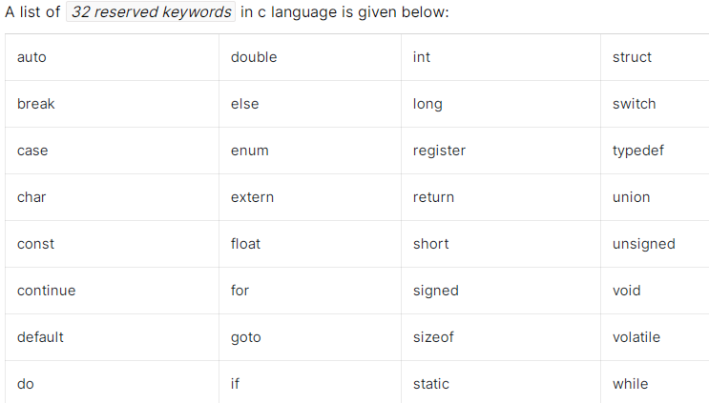
C Keywords

Slide 19
Data Types in C
Data type is classification of a particular type of information.
Data types are essential to any computer programming language.
Without them, it becomes very difficult to maintain information within a computer program.
Different data types have different sizes in memory depending on the machine and compilers.
In C language, data types can be classified into three parts:-
1. Primitive/Basic data types/Fundamental data types
2. Derived data types
3. User-defined data types

Slide 20
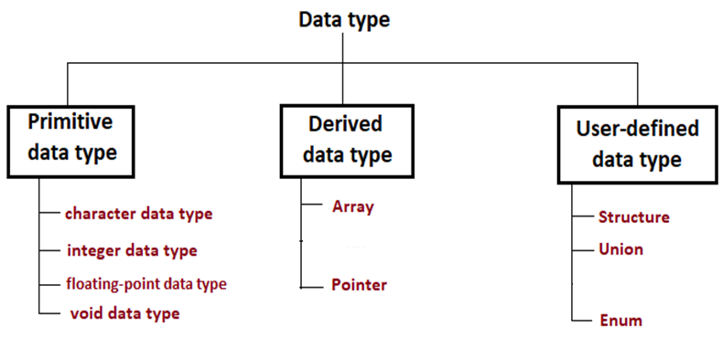
Data types can be classified into three parts

Slide 21
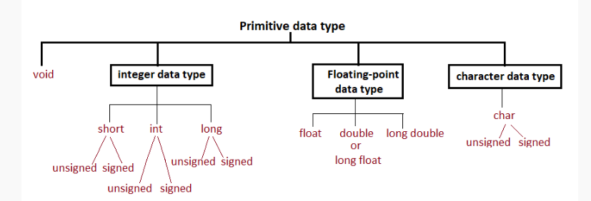
Primitive data types
In C there are three types of basic data types: character data type, Integer data type, floating-point data, and void.

Slide 22
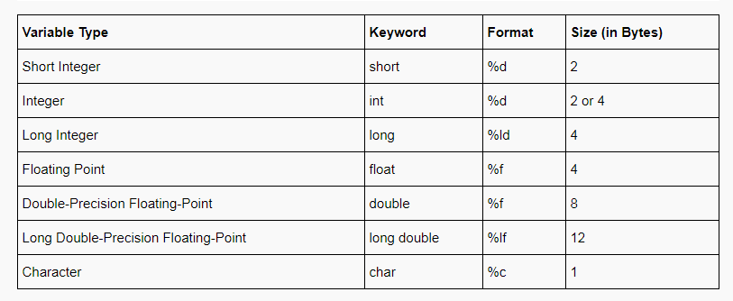
Primitive data types

Slide 23
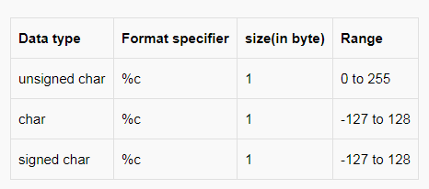
1. Character data type
In C language, to store character data types keyword char is used.
For character type variables and single-character constants, 1 byte (8 bits) of memory space is allocated.
Example of char data types:- ‘m’, ‘A’, ‘5’, ‘@’, ‘?’ etc..
Note that all are inside the single quotation.
“a” is not a char data type because it is inside double quotation not in the single quotation.
‘abc’ is not a char data type because inside a single quotation only one character must be present.
‘ ’ is a char data type, space is inside a single quotation and space is a valid character.

Slide 24
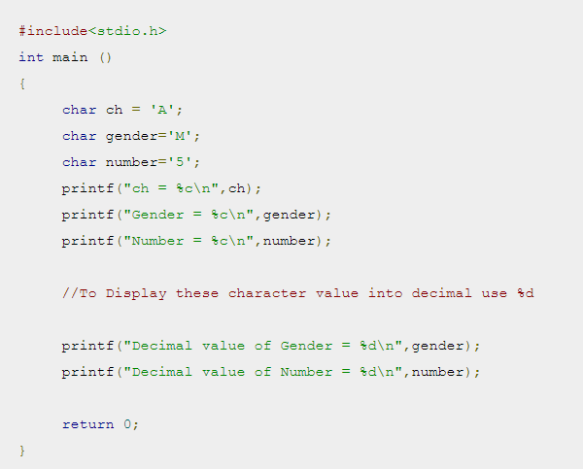
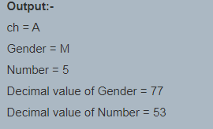
Example

Slide 25
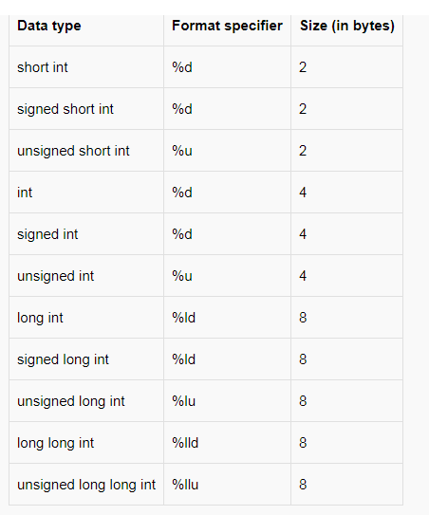
2. Integer data type
The keyword int is used to declare integer data type.
If integer data is small then we can use keyword short or short int and to store long integer number we can use long or long int keyword and to store very long number we can use long long or long long int keyword.

Slide 26
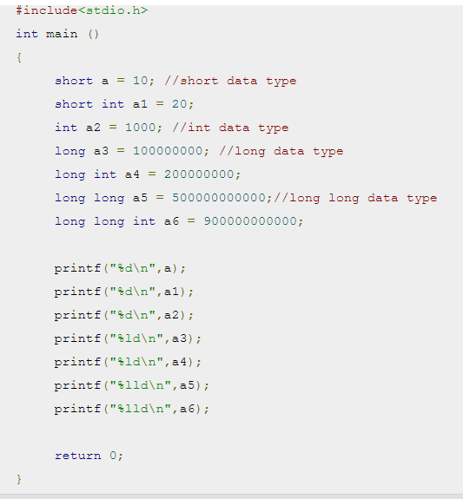
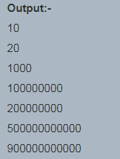
Example

Slide 27
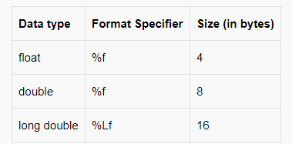
3. Floating point data type
By default, every floating-point number is treated as a double data type. Float and long double data type are also used for floating-point.
Sometimes every real-world value can’t be stored using integer, floating-point values are required. For example to calculate the weight of person floating-point values are required.

Slide 28
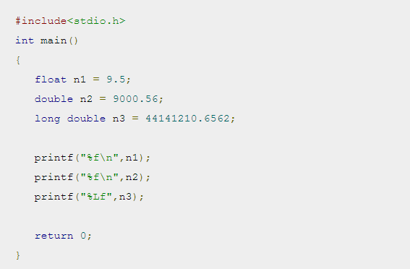
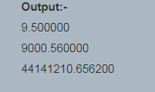
Example

Slide 29
4. Void
As the name indicates this type has no values.
Most of the times it is used to indicate that a function does not return any value.
All other primitive data types short, int, long int, float, double and long double can be used for both calculation (like storing values to a variable) and returning from a function but void can only be used for returning from a function.
Void can’t be used for storing and calculation in a program.

Slide 30
Derived Data Types
These data types are defined by user itself.
Like a collection of integer stored contiguous makes an array.
So derived data types are what we can create by combining various primitive data types. Using derived data types, an infinite variety of new types can be formed.
Types of derived datatypes in C
There are basically three derived types in C:
1. Array
2. References
3. Pointer

Slide 31

Array:
Arrays are one of the mostly used derived datatypes in C and they can be formed by collecting the primitive datatypes like – float ,int or char.
Arrays are used to perform operations on some homogeneous set of values.
The size of the array type is determined by the data type of the array and the number of elements in the array.
Each element in an array has the same type.
For example,
Each of the element has the size of a char object, 8 bits.

Slide 32
2. Pointer:
Pointers are considered by many to be complex in C, but that is not the case.
A pointer is just a variable that stores the address of another variable.
A pointer can store the address of variables of any data types.
The pointer is defined by using a ‘*’operator.
For example,

Slide 33
User defined data types in C
Those data types which are defined by the user as per his/her will are called user-defined data types.
Examples of such data types are
Structure
union
enumeration.

Slide 34
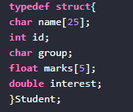

1. Structure:
A struct is a composite structure that can contain variables of different data types.
For example, all the student data can be put under one structure.
For example,
A structure can be created outside the main method as well as inside, just before creating the variable to use it.

Slide 35
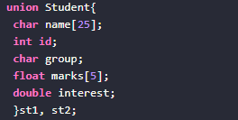
2. Union:
With a union, you can store different data types in the same memory location.
The union can have many members, but only one member can have a value at one time.
The union is defined in the same way as a structure but with the keyword union.

Slide 36
3. Enumeration:
Enumeration data type consists of named integer constants as a list.
It start with 0 (zero) by default and value is incremented by 1 for the sequential identifiers in the list.
Enum syntax in C: enum identifier [optional{ enumerator-list }];
Enum example in C:
enum month { Jan, Feb, Mar }; or /* Jan, Feb and Mar variables will be assigned to 0, 1 and 2 respectively by default */ enum month { Jan = 1, Feb, Mar };

Slide 37
Derived Data Types vs User Defined Data types in C
Derived data types are created from basic data types such as int, float, char, etc.
Example of Derived Data Types in C: Arrays, Pointers, Structures, etc.
Using user-defined data types, the programmer can invent his/her own data types in C programming. It does not necessary to use basic data types to create user-defined data types in C.
Example for User Defined Data Types in C: typedef (type definition), enum (enumerated data type)

